Slide 1

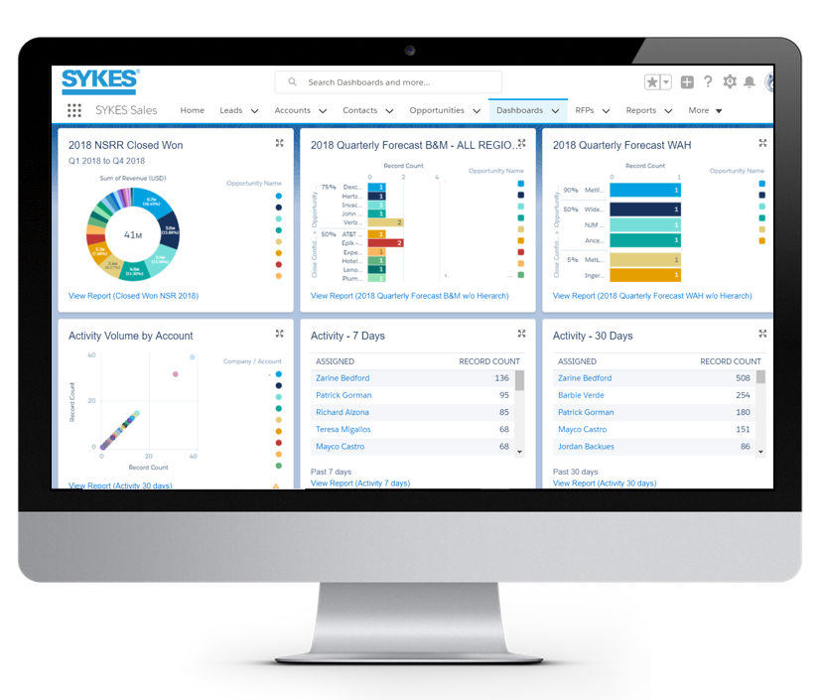
SYKES – Salesforce Redesign & Managed Service
Business Need
A $1.5B leader in enterprise Business Process Outsourcing, SYKES came to Affirma for support in completely redesigning their Salesforce environment and business process across a global user base. Their Salesforce environment had been implemented and maintained with poor architecture, weak data integrity, and a fragmented user experience.
Scope of Partnership
Capturing and defining business/functional requirements
from 40 immediate stakeholders to support hundreds of end users.
Technical Approach & Architecture Design: Full redesign of Sales Cloud,
migration from existing org to new org along with conversion from Classic to Lighting Experience.
Salesforce redesign, development, integration, deployment, and end user change management.
Ongoing Quality Assurance & UAT Support; Training for business leads, developers, and end users
Ongoing managed service support with Business Analyst, Technical Lead, and Development teams.

Slide 2
SYKES – Salesforce Redesign
Goal
A $1.5B leader in enterprise Business Process Outsourcing, SYKES came to Affirma for support in completely redesigning their Salesforce environment and business process across a global user base. Their Salesforce environment had been implemented and maintained with poor architecture, weak data integrity, and a fragmented user experience.
Deliverables
Capturing and defining business/functional requirements
from 40 immediate stakeholders to support hundreds of end users.
Technical Approach & Architecture Design: Full redesign of Sales Cloud,
migration from existing org to new org along with conversion from Classic to Lighting Experience.
Salesforce redesign, development, integration, deployment, and end user change management.
Ongoing Quality Assurance & UAT Support; Training for business leads, developers, and end users
Ongoing managed service support with Business Analyst, Technical Lead, and Development teams.

